Slide 1
Test Time.
When told to, turn over your sheet and begin.
You will have 25 minutes to do the test, so manage your time!

Slide 2
Time’s up.
Pass the paper to the person next to you. We’ll go through the answers and mark them, then I will take all papers in to look at them myself…so no being nice to your neighbour!

Slide 3
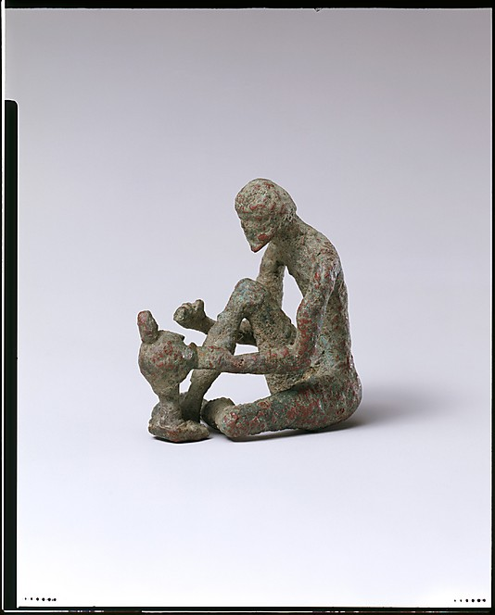
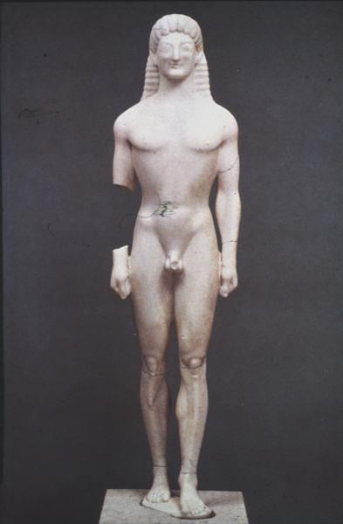
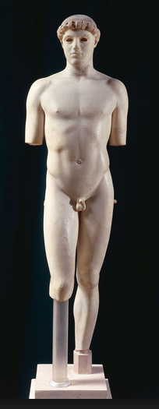
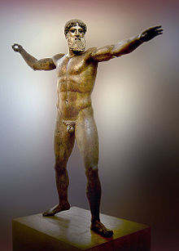
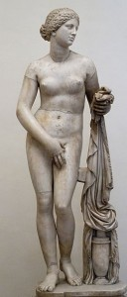
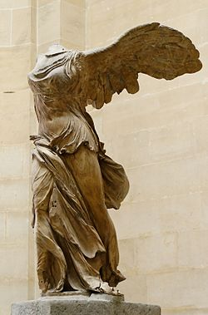
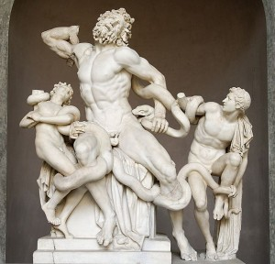
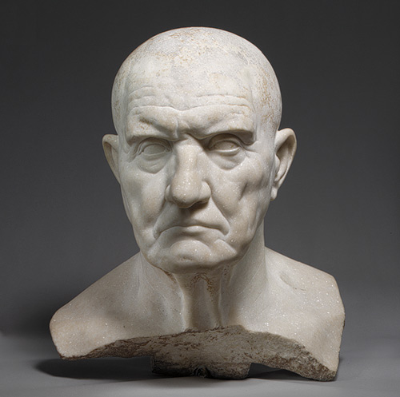
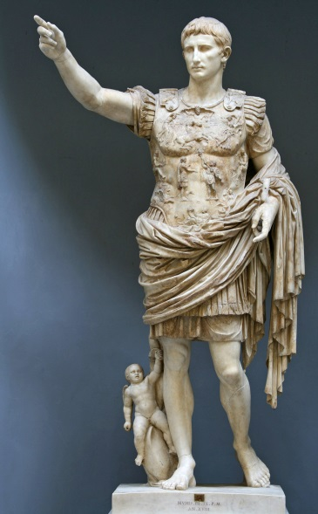
Helmet-maker c. 700 BC. Bronze, Dark Ages/Geometric Period.
Kouros from Tenea c. 570 BC, Marble, Archaic
Kritios Boy c. 480 BC Marble, Early Classical
Artemision Bronze 470-440 BCE, Bronze, High Classical
Aphrodite of Knidos 4th century BC. Marble, High Classical
Winged Victory of Samothrace, Marble
c. 200-190 BC. Hellenistic
Laocoon,
Marble, Hellenistic
Portrait bust of a man,
1st century BC Marble, Roman
Augustus of Prima Porta 1st Century AD
Roman

Slide 4
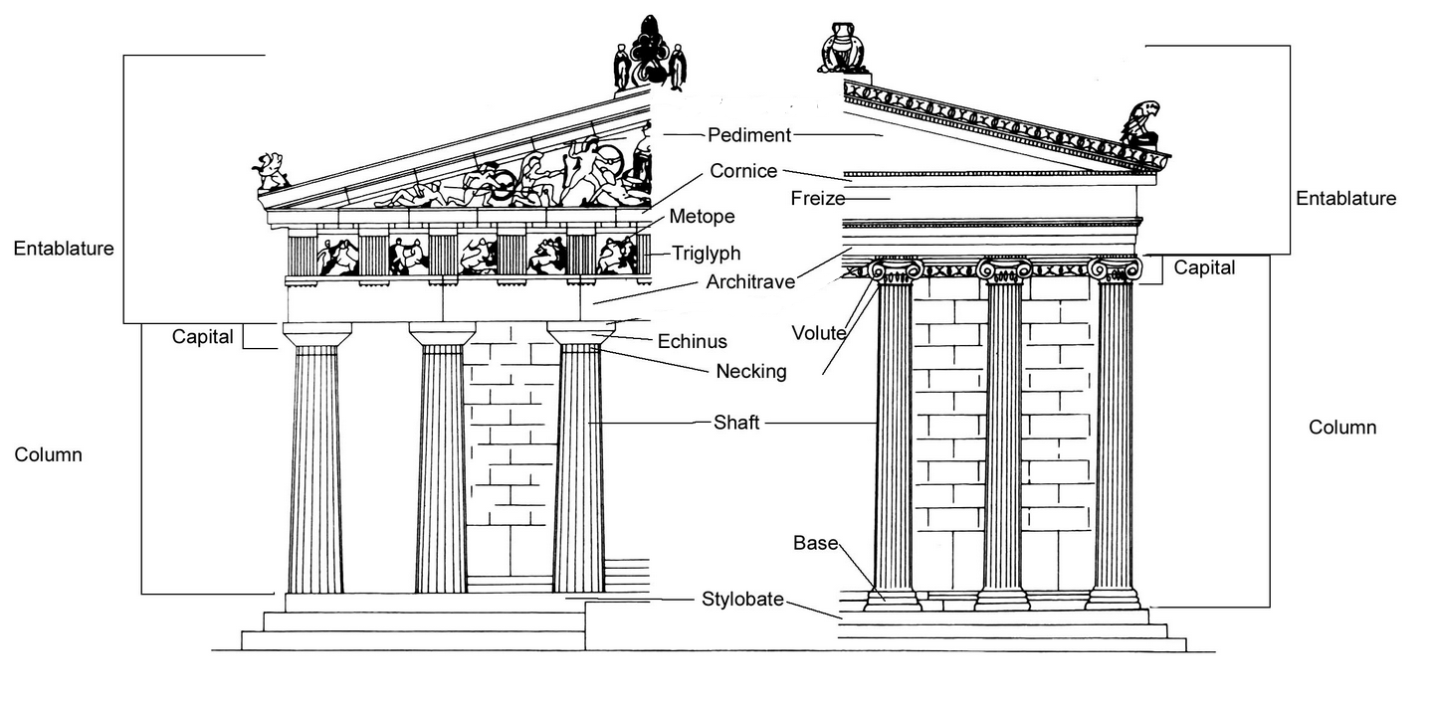

Slide 5
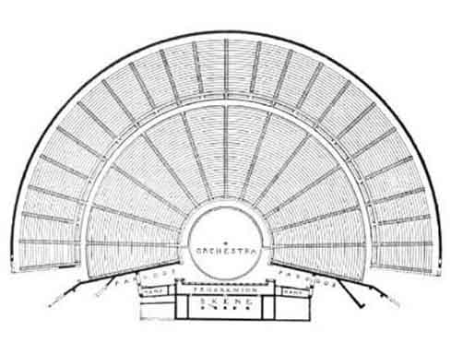
1 – Theatron – This is where the audience sat. This is where we get out word theatre from.
2 – Orchestra – This is where the chorus performed. This is where the modern meaning of orchestra comes from.
3 – Skene – This is the stage upon which the actors performed. Skene is where we get the word ‘scene’ from.
4 – Parodos – This was the players entrance and exit. This is where we get the word parade from.
The anatomy of a Greek theatre…
1
2
4
4
3
Ground plan of the theatre at Epidauros.

Slide 6
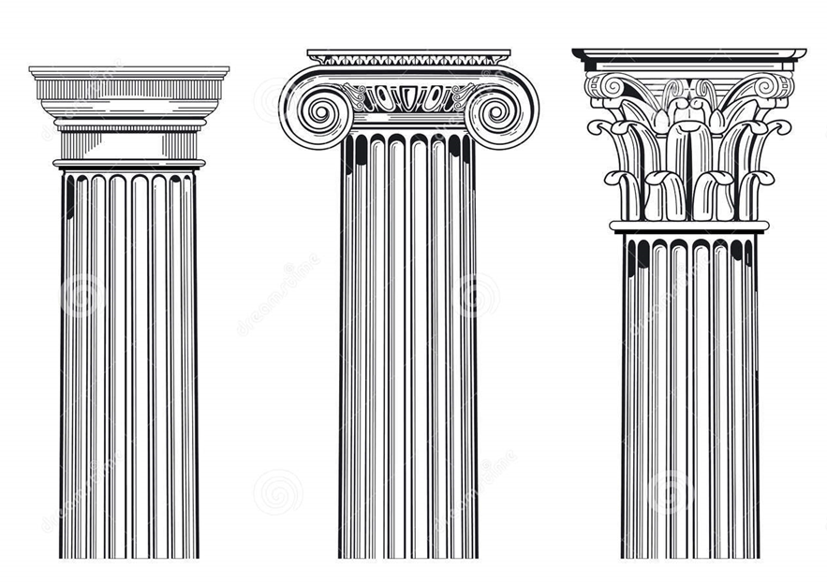
And lastly… Corinthian!
Doric
Ionic
Corinthian

Slide 7
1, What were the 4 periods of Ancient Greece we studied?
2, Which empire did the Greeks eventually defeat, and roughly when?
3, What was the name of the war between Athens and Sparta? Who won?
4, Who came to power after the Spartans went into decline?
5, Roughly when was the Roman Republic?
6, What did Pericles build in Athens during the classical period?
7, Name some cultural achievements of the Hellenistic period…
8, What did the Roman Empire get many of their early ideas from?

Slide 8
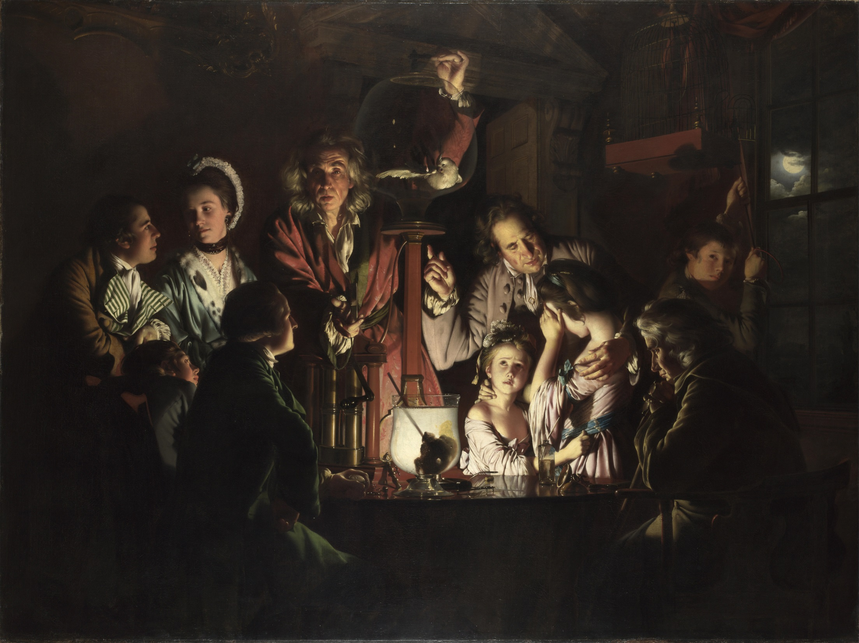
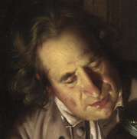
More detail and ‘focus’ in the foreground of the painting.
Pictorial Space:
Use of light and shade and tonal modelling in order to create a sense of 3D objects in space.
Overlapping of features/objects.
Foreshortening to create a sense of depth.
Compositional arrangement that leads viewer ‘into’ the painting’. See how the family frame the light portion of the painting to make the contrast between light and dark even greater…

Slide 9
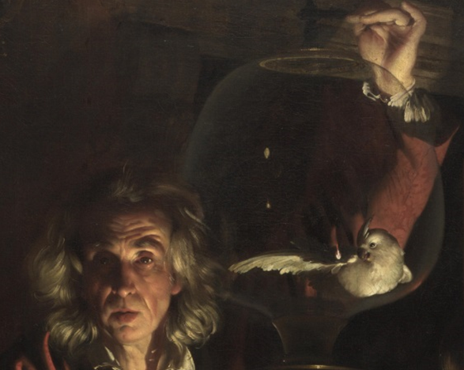
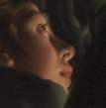
Picking out important elements of a narrative or picture.
Light and Tone
Clarifying details.
Modifying the colours of a picture.
Creating mood or atmosphere.
Highlighting the composition of the painting.

Slide 10
Look through the Themes of Hart 2. Some of these you will already be fairly familiar with.
These will form the basis of your teaching across all of your art history lessons from next lesson.
As we look through the following images, ask yourselves which themes might be explored, what questions asked, and whether you can answer, or guess at, anything relevant to each theme.
This is a discussion based lesson, so this will only be as useful and interesting as you guys make it…
Make notes of the works of art and any interesting or useful class observations as we go along.

Slide 11
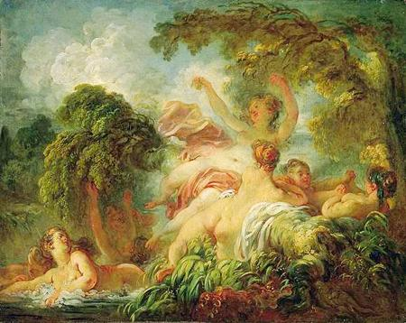
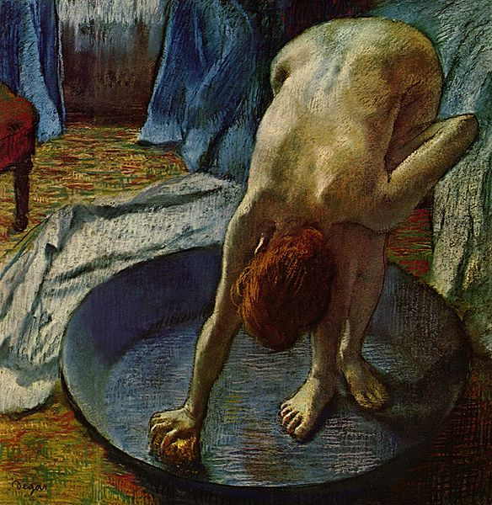
The Bathers, Jean-Honore Fragonard, c.1765, oil on canvas, 80 x 64 cm
Woman in the Bath, Edgar Degas, 1886,

Slide 12
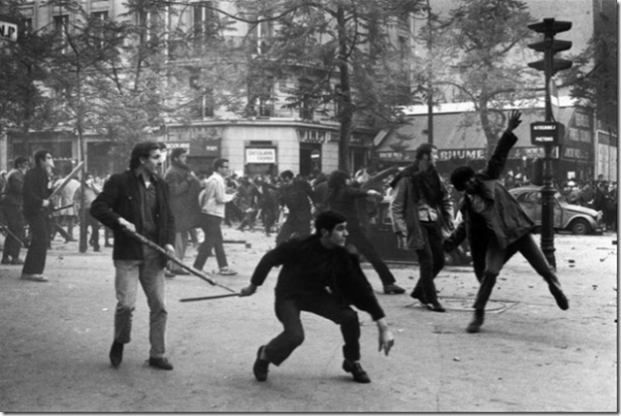
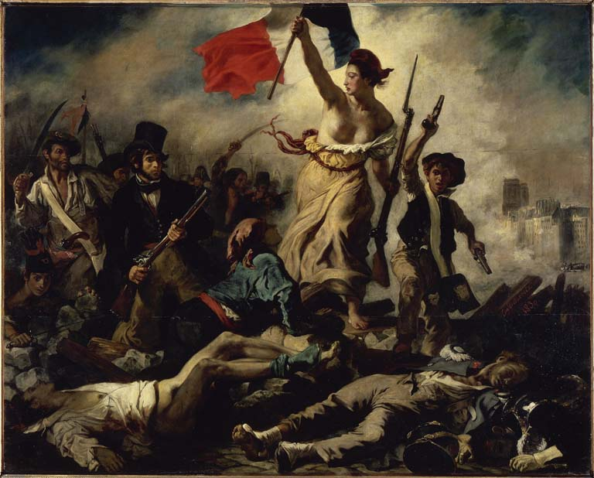
Bruno Barbey, Paris. May 6, 1968, ca. 1968
Vintage gelatin silver print, 11 x 14 in
Liberty Leading the People, Eugène Delacroix, 1830, Oil on canvas, 260 cm × 325 cm ,

Slide 13
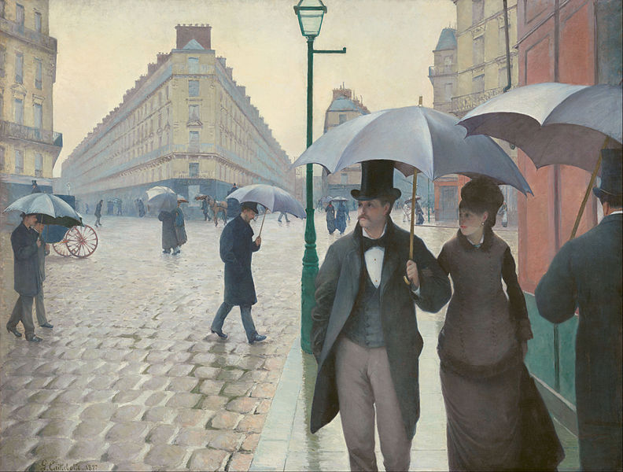
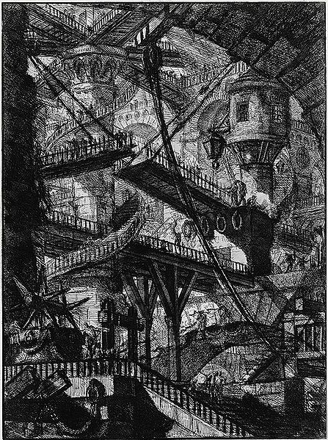
Paris Street; Rainy Day, Gustave Caillebotte, 1877, 212.2 × 276.2 centimetres
Untitled etching (called "The Drawbridge"), plate VII (of 16), from the series The Imaginary Prisons (Le Carceri d'Invenzione), Giovanni Battista Piranesi, 1761 edition (reworked from 1745).

Slide 14
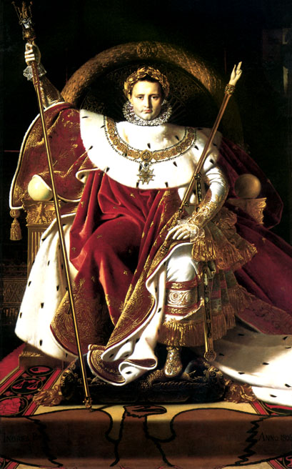
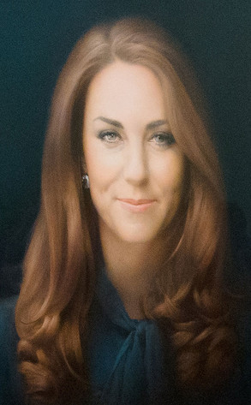
Napoleon I on his Imperial Throne, Jean Auguste Dominique Ingres, 1806, oil on canvas, 259 cm × 162 cm (102 in × 64 in)
Portrait of Catherine, Duchess of Cambridge, Paul Emsley, Oil on canvas, 2012, 115.2 x 96.5 cm

Slide 15
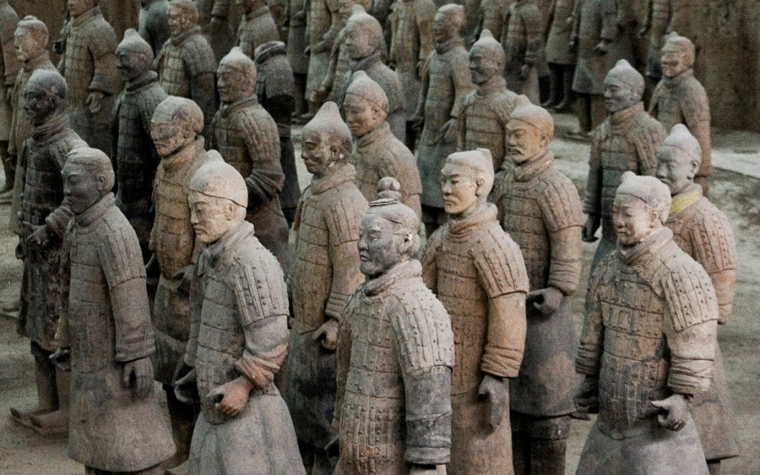
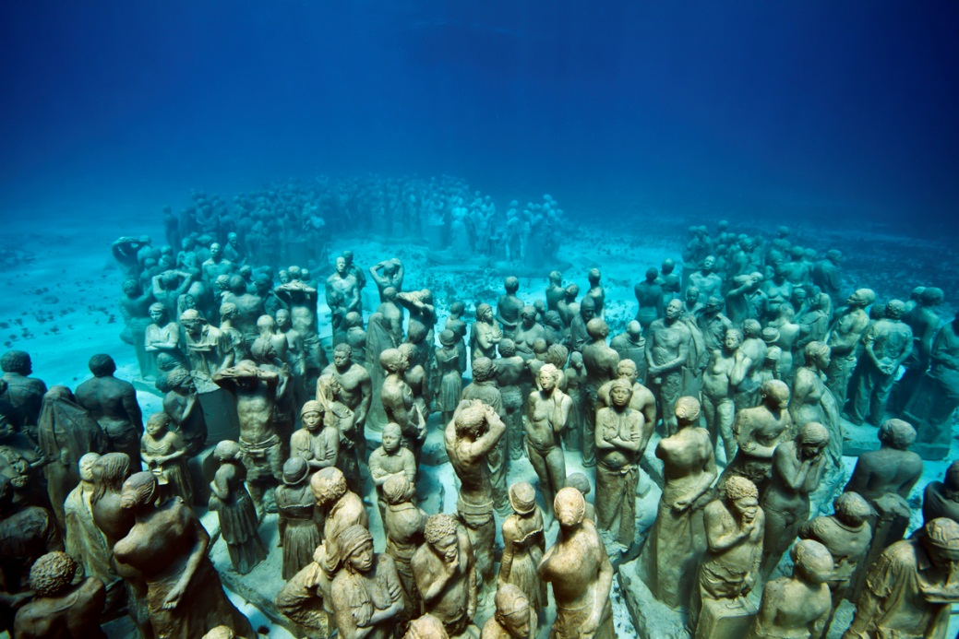
The Terracotta Warriors, Terracotta , Life-size.
The Silent Evolution, Jason de Caires Taylor, Concrete , Life-size, 8m deep.

Slide 16
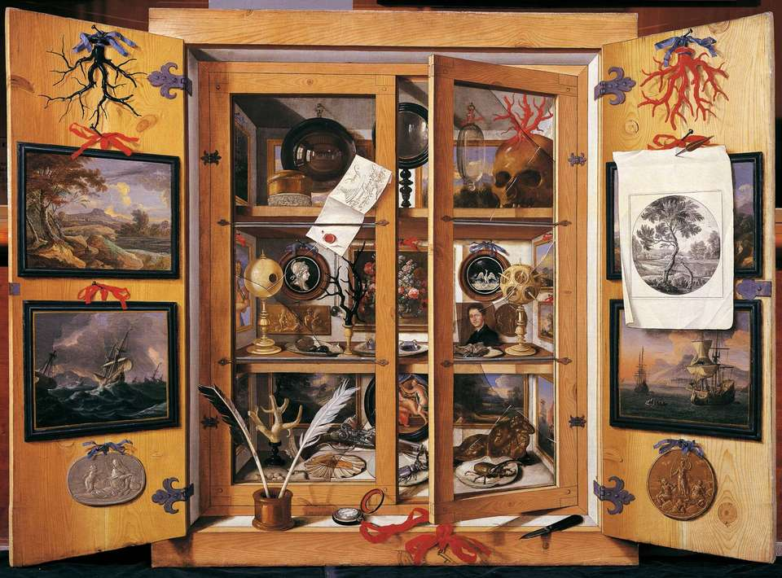
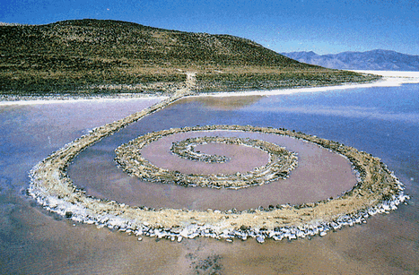
A Cabinet of Curiosity, Domenico Remps, 1690s, oil on canvas. 99 cm (39 in) x 137 cm (53.9 in)
Spiral Jetty, Robert Smithson, 1970, Mud/Precipitated salt crystals/Rocks/Water
4.572 m × 457.2 m

Slide 17
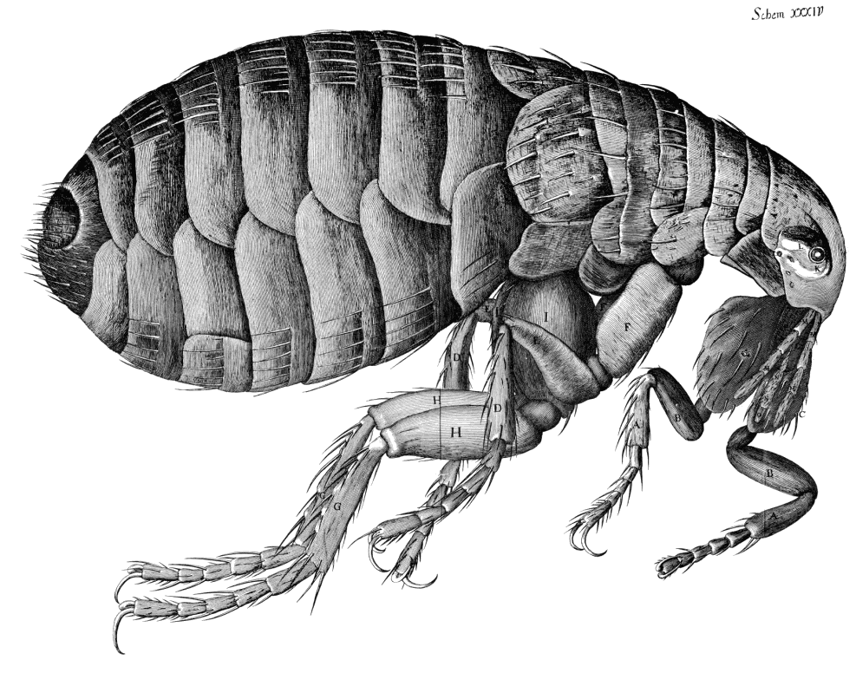
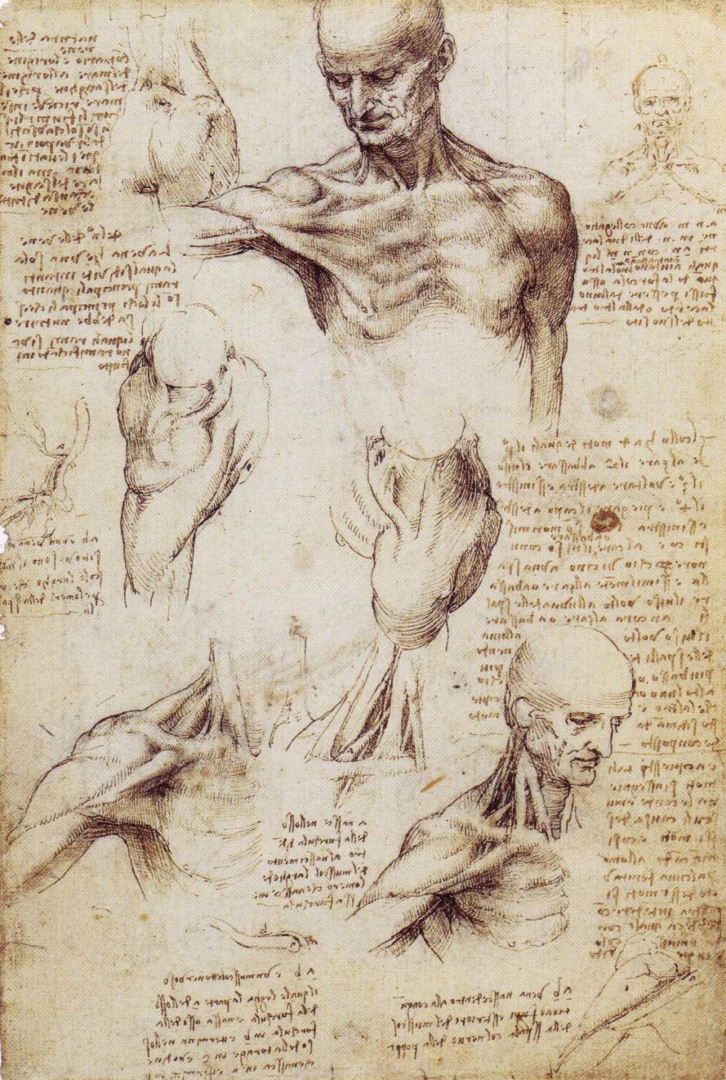
Drawing of a Flea, from Micrographia, Robert Hooke, 1665
Recto: The superficial anatomy of the shoulder and neck. Verso: The muscles of the shoulder, Leonardo da Vinci, 1510-11, Pen and ink with wash, over black chalk

Slide 18
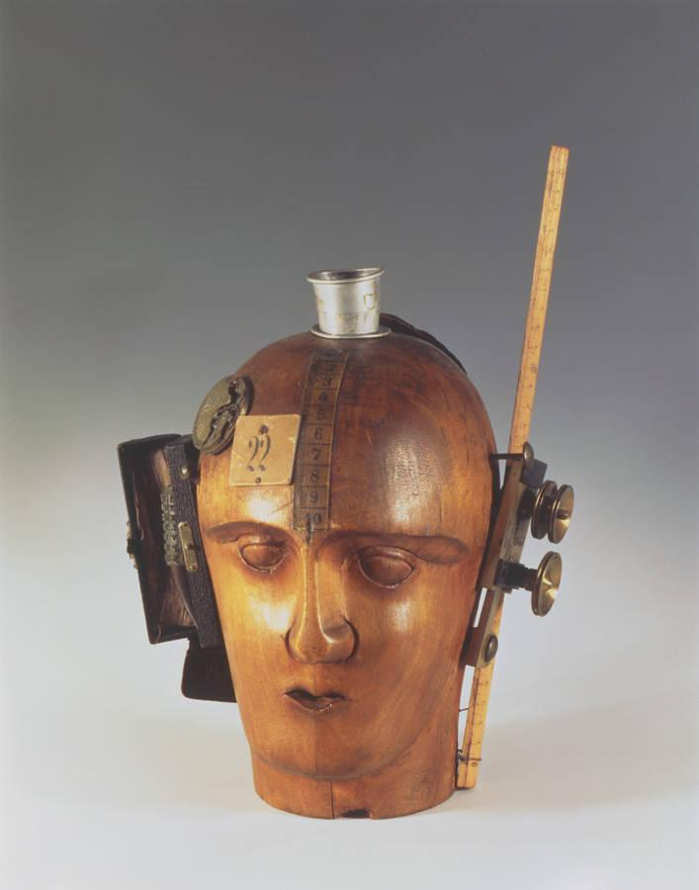
Mechanical Head (The Spirit of Our Time), Raoul Hausmann, assemblage, circa 1920
Portrait bust of a man,
marble, 1st century BC

Slide 19
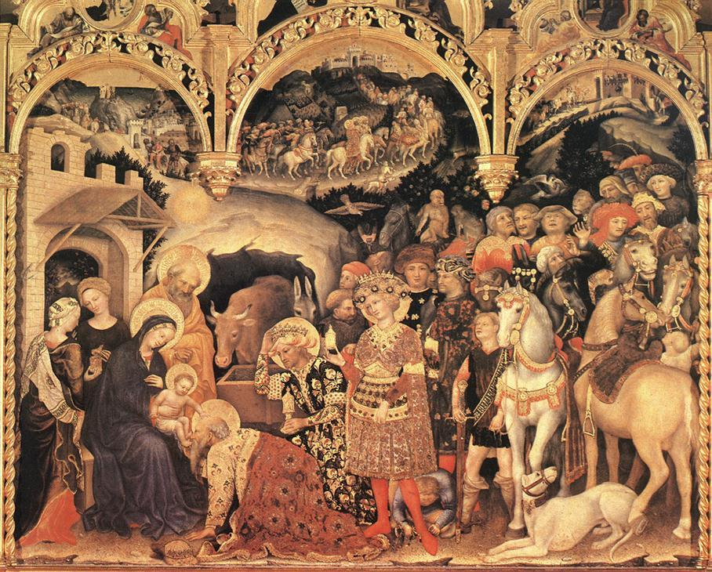
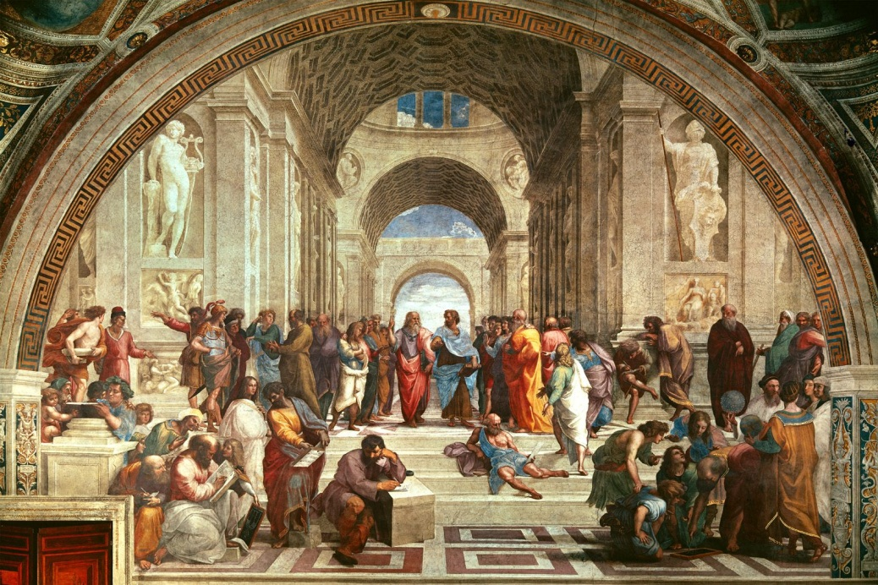
Adoration of the Magi, Gentile da Fabriano, 1423, Tempera on panel, 203 cm × 282 cm (80 in × 111 in)
The School of Athens, Raphael, 1509, 5 x 7.7m

Slide 20
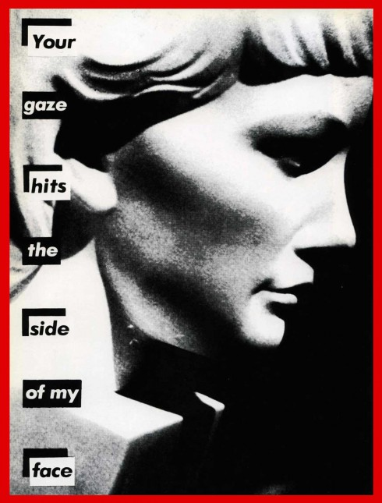
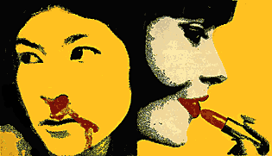
Your gaze hits the side of my face, Photograph with Futura Bold typeface against black and white text bars, Barbara Kruger, 1981
José Gómez Fresquet (Frémez), circa 1970. Silkscreen on paper 18 3/8 x 24 1/8 inches

Slide 21
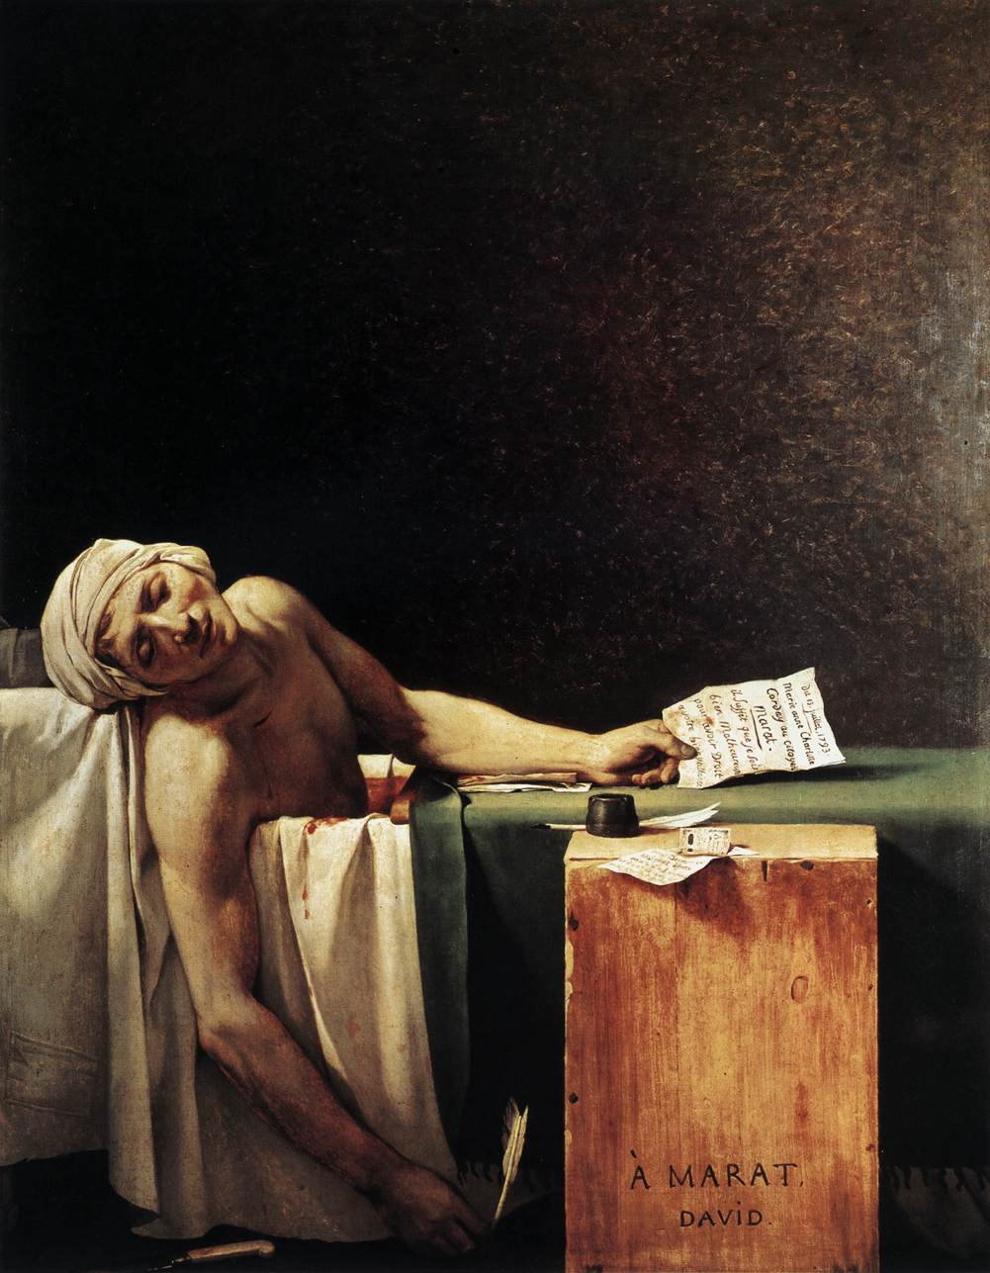
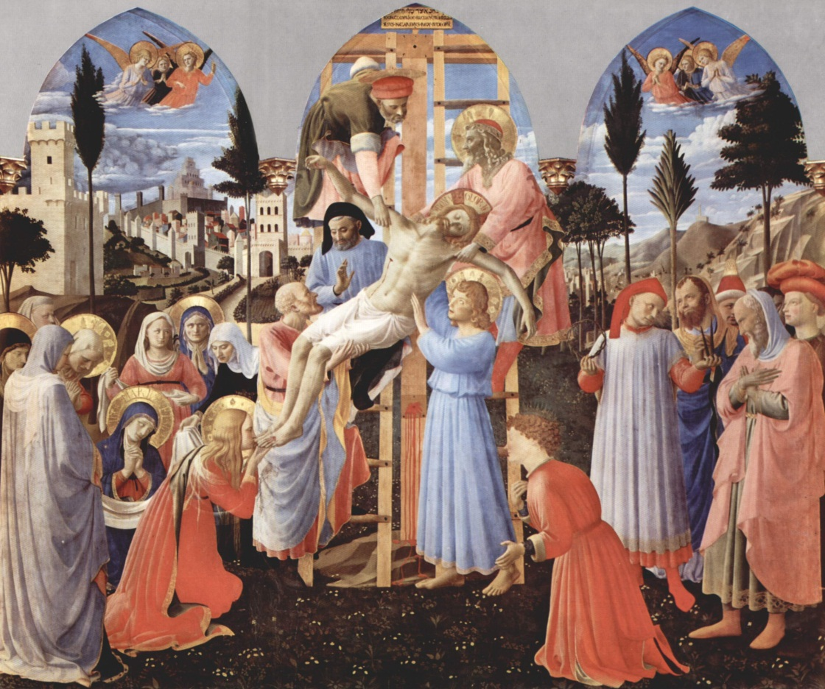
Deposition of Christ, Fra Angelico, c. 1432-4, Tempera on panel, 176 cm × 185 cm
The Death of Marat, Jacques-Louis David, 1793, oil on canvas, 165 cm × 128 cm (65 in × 50 in)

