Slide 1
Roman architecture: new way of doing things?
We’re about to watch a video (with terrible sound…apologies) which outlines some of the key differences between Greek and Roman architecture.
Make notes on:
Key developments and specific buildings which utilise these. Think about the way in which materials of construction and design helps to fulfil the intended function of the architecture.

Slide 2
A quick clip on the making of concrete, from an interesting documentary on the making of a Roman bath house…in case you’re interested in watching it later...
https://www.youtube.com/watch?v=dapc1bhkAKE
C. 13:12 – 15:30

Slide 3
Hart 1: Visual Analysis and Interpretation.
A quick reminder of what you need to know about this paper:
It is not a paper that tests your knowledge, but rather your ability to look at and comment on an aspect of art or architecture, have some idea of how the artwork WORKS and make meaningful observations with subject specific vocabulary that allow you to answer the question.
(Your glossary will be very useful to this…add to it and LEARN THE WORDS!)
The examples you will be given in a separate booklet (one picture, one piece of sculpture and one piece of architecture) are not necessarily ones you will ever have looked at. They could be ANYTHING at all. The trick is to look carefully and comment only on what you can see…background knowledge is not given any marks at all.
Each question is worth 20 marks…that means that you need to make roughly 20 observations or separate points about a work of art that are relevant to the question you have been asked in order to get full marks!

Slide 4
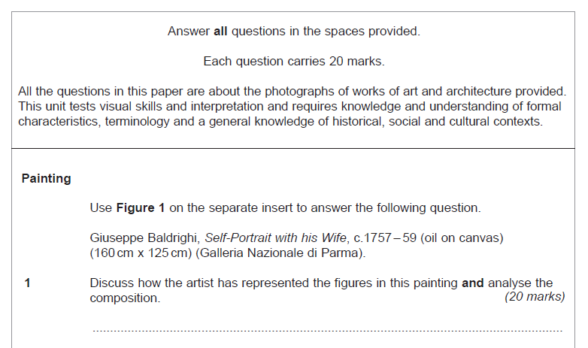
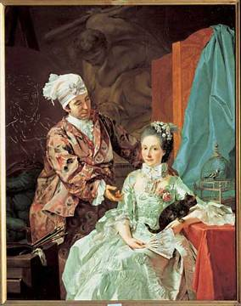
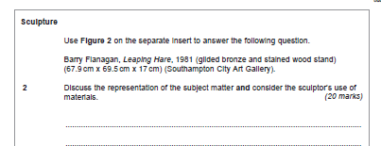
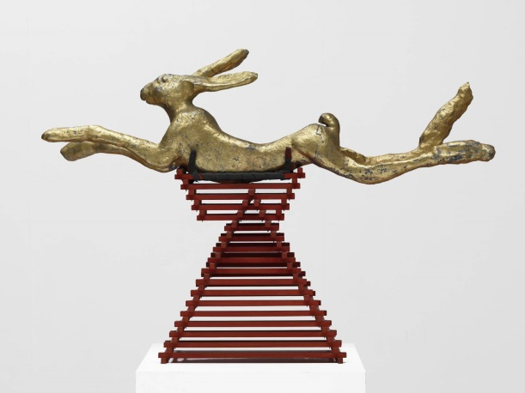
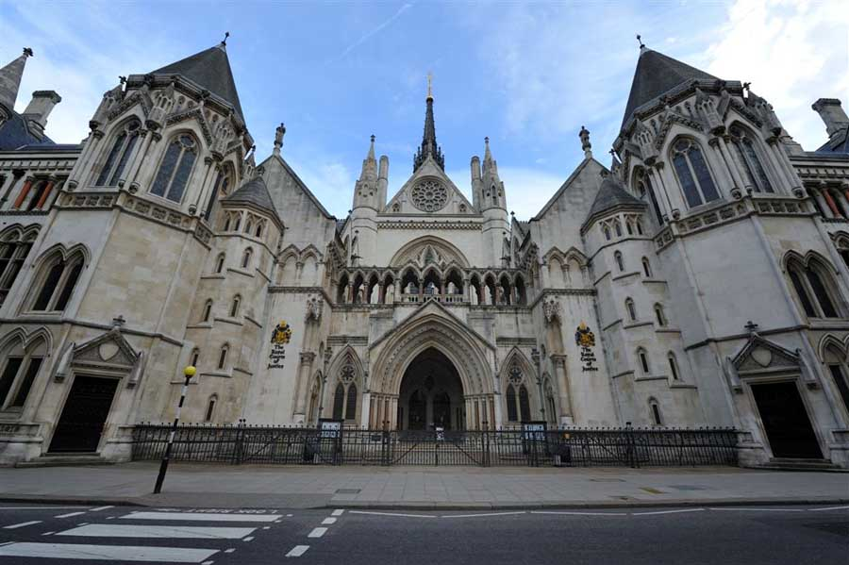
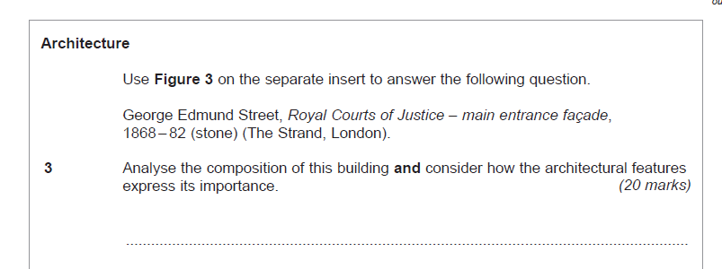

Slide 5
Analyse the composition of this building and consider how the architectural features express its importance:
Analyse the composition of this building and consider how the architectural features express its importance:
This is one of the kinds of question you may get in Hart 1 – visual analysis and interpretation. This paper asks you to use your eyes and your words (precise and subject specific vocab is crucial) to accurately describe and interpret what you see and answer the question.
What do you notice about the question?
How many parts does it have to it?
What does the question actually want you to do?
What would you have to do to analyse the composition of the building?
What does ‘consider how the architectural features express its importance’ actually mean?

Slide 6
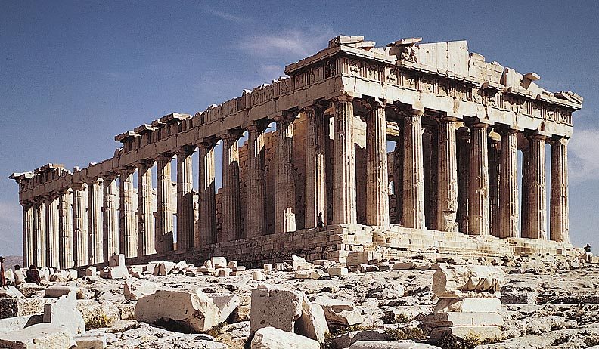
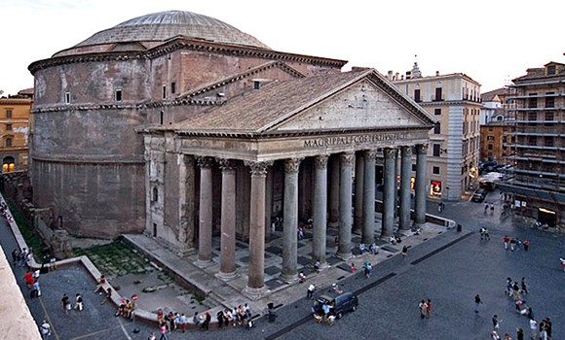
Analyse the composition of this building and consider how the architectural features express its importance:
In groups of 4, annotate the A3 sheets of the Parthenon with as many details as you can which help answer the question. If you finish before another group, try and have a go at the Pantheon on the other side.

Slide 7
What observations did we make?
Did we stick to the question?
Did we use any subject specific vocabulary?
Did you justify your observations?
Did you include any contextual or historical knowledge that is not relevant?

Slide 8
Part of an answer for the Pantheon, which I rustled up earlier…and then finished as I realised it is not a building you could ever really be given…there isn’t that much to say about the exterior without more of the original exterior being there!
Look at the style, use of vocab throughout and absence of historical context.
The building has a projecting Greek temple-front portico in front of the main portion of the building. An even, and therefore symmetrical number of Corinthian columns support the entablature, frieze and pediment, which alludes both to the building’s importance and its religious function. The frieze, free from any sculptural motifs, blunts the vertical thrust of the columns and supports the pediment and tympanum above, which in turn taper out horizontally to diminish the horizontal thrust of the portico. The uniformity of the columns, combined with their size, as well as the surface decoration and size of the pediment, likewise create a sense of grandeur.
I am not expecting this from you yet, so do not panic…the trick is to think about new words as they come up and what different features of architecture and compositional arrangements are there for!

Slide 9
Homework:
Take a photo of your labeled A3 sheets and use it (along with your handouts from last lesson) to try and write a paragraph which would answer the question. In the real exam you will get roughly one mark per observation that you make and explain…I am looking for ten in your paragraphs, but any more will impress.
Analyse the composition of this building and consider how the architectural features of the Parthenon express its importance:

